Slide 1
EXCEL CAPSTONE-1
J.charitha

Slide 2
TOPIC : Survey conducted by government
of India.

Slide 3
1.
What is the number of women aged 15-49 years worked in the last 12 months and were paid in cash in the region Ladakh?
States/UTs | Number of Women age 15-49 years | Women (age 15-49 years) who worked in the last 12 months and were paid in cash (%) | Total
Ladakh | 2355 | 28.31 | ₹ 667

Slide 4
2.
What is the difference in number of men aged 15 years and above who consume any kind of tobacco in rural and urban regions of Tamil Nadu?
States/UTs
Tamil Nadu
Area | Number of Men values | Men age 15 years and above who use any kind of tobacco (%) | Total | Difference
Urban | 1459 | 16.7 | 244
Rural | 1913 | 23.3 | 446 | 202
Total | 3372 | 20.1 | 678

Slide 5
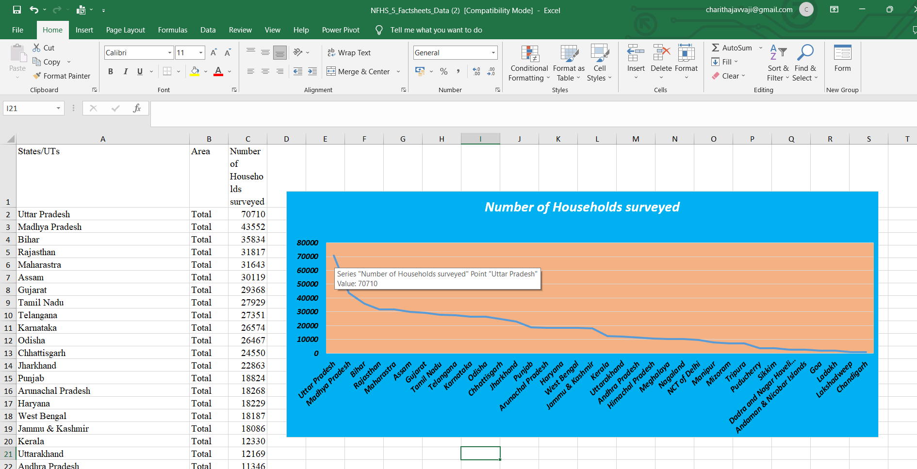
3.
Create a visuals of how many Households were surveyed in each State/UT?

Slide 6
4.
Are there any two or more columns which are co-related to each other? Justify your
answer with 200–300 words paragraph. (Adding visuals, tables, etc are encouraged)
Yes,
There are more columns which are co-related to each other, and according to the given data I choose that what’s the difference for both men and women. And women who are literate and men who are literate at age of 15-49 years and for women who have comprehensive knowledge of HIV/AIDS and for men also who have comprehensive knowledge on that HIV/AIDS and the age is here also 15-49 years.
co-related | Women (age 15-49) who are literate⁴ (%) | Men (age 15-49) who are literate4 (%) | Women (age 15-49 years) who have comprehensive knowledge²⁴ of HIV/AIDS (%) | Men (age 15-49 years) who have comprehensive knowledge²⁴ of HIV/AIDS (%)
Women (age 15-49) who are literate⁴ (%) | 1 | 0.95 | 0.73 | 0.77
Men (age 15-49) who are literate4 (%) | 0.95 | 1 | 0.64 | 0.74
Women (age 15-49 years) who have comprehensive knowledge²⁴ of HIV/AIDS (%) | 0.73 | 0.64 | 1 | 0.73
Men (age 15-49 years) who have comprehensive knowledge²⁴ of HIV/AIDS (%) | 0.77 | 0.74 | 0.73 | 1
Here we can see the table what I created mean and we all know that for both we have the same data it gives “1” and It calculates the actual relationship b/w two values. To determine the relationship b/w two properties ,It tells how strongly related to each other.
And the next slide I created that some symbols of women and men and I filled with the matched colors for men and women who are literated and for men and women who have comprehensive knowledge of HIV/AIDS and according to the co-related I created chart, we can see in that what the related for all I taken, So we can see the chart on next slide.

Slide 7
*
Who have comprehensive knowledge of HIV/AIDS
⓪ ①
Men age(15-49) Women age(15-49)
*
Who are literate
① ⓪
Women age(15-49) Men age(15-49)

Slide 8
5.
Out of the given data identify a problem statement and explain what measures are
to be taken to solve the problem?
Problem statement :
In the given data I choose the deaths in the last 3 years registered with the civil authority. I selected <9.5% of states and areas and in the state of Dadra and Nagar Haveli & Daman and Diu the total is 95.4%,for the rural areas the death rate is 99.6% and for urban areas the death rate is 91.5%. the next state is goa the total for that is 100%, for the rural and urban both areas also the death rate is 100%. And next is kerala the total for that is 97.4%, for rural areas 96.9% for urban areas 98.0%. And for Lakshadweep the total is 96.6%. Here the 100% is in goa state the from last 3 years the death rate is very high than compare to other states.

Slide 9








Solutions that save lives, reduce child mortality :
The main cause of death for children is infectious diseases.
❖
❖
Improved access to water ,sanitation ,hygiene.
❖
Skilled attendants for antenatal,birth,and postnatal care.
❖
It must be a good medical , ,educational fecilities close to the place of living.
❖
They have to access healthy nutrition and micronutrients.
C

Slide 10

Thank you

